Slide 1
Capstone Project -1
Airbnb Bookings Analysis (EDA)

Slide 2

Table of Content
1
Introduction of ‘Airbnb’
2
Data Summary & Variables
3
Exploratory Data Analysis
4
Challenges Faced and Conclusion

Slide 3
Introduction
Airbnb was founded in 2008 by Brain Chesky , Nathan Blecharczyk and Jeo Gebia.
Airbnb is an online marketplace connecting travelers with local hosts. On one side, the platform enables people to list their available space and earn extra income in the form of rent. On the other, Airbnb enables travelers to book unique homestays from local hosts, saving them money and giving them a chance to interact with locals. Catering to the on-demand travel industry, Airbnb is present in over 190 countries across the world . Airbnb does not own any of the listed properties .
Airbnb offers around 6 million places to stay in throughout the world. At any given time, guests book 1.9 million listings in Airbnb.
Airbnb was founded in 2008 by Brain Chesky , Nathan Blecharczyk and Jeo Gebia.

Slide 4
Here we are going to do an Exploratory Data Analysis on the data set of Airbnb NYC (2019).
This dataset has around 49,000 observations in it with 16 columns and it is a mix between categorical and numeric values.
Our main objectives of analysis will be the some of statements given to us which can be briefed as learnings from hosts, areas, price, reviews, locations etc. But we are not limited to it , we will also try to explore some more insights.

Slide 5
Data Summary
In this session, we will have the overview of the basic understanding of our dataset variables. What does particular features means and how its distributed, what type of data is it. Airbnb dataset is having 16 columns in total. We can get this by basic inspection of our dataset. Some columns are not significant for our analysis which can also be kept off.
Now let’s look at some of the useful columns in our data set.

Slide 6
Data Summary continued….
Id
Host_id
Last_review
Latitude
Unique
Date
Longitude
Name
Price
Host_name
Airbnb Data
Categorical
Numeric
Minimum_night
Neighbourhood
Number_of_reviews
Neighbourhood_Group
Reviews_per_month
Room_type
Calculated_host_listing_count
Availability_365

Slide 7
Understand the variables
ID:
  It’s a unique id for House/apartment.
Name:
  Name of the listing House/apartment.
Host Id:
  Host Id is the government approved id for each individuals Who rent their properties on Airbnb.
Host Name:
  Host names are basically the name of the individual or organization Who own a room/apartment on Airbnb website.
Neighbourhood groups:
  Neighbourhood groups are the cluster of neighborhoods in the area.
  There are about 5 neighbourhood in the state.
Neighbourhood:
  When searching for accommodations in a city, guests are able to filter by neighbourhood attributes and explore layers of professional-quality content, including neighbourhood maps, custom local photography and localized editorial, details on public transportation and parking, and tips from Airbnb’s host community.
Latitude:
  Latitude is the measurement of distance north or south of the Equator.
Longitude:
  Longitude is the measurement east or west of the prime meridian.

Slide 8
Room type:
  Airbnb has 3 categories for types of space :
    Entire House/Apartment
    Private room
    Shared room
Price ($):
  The total price ($) of Airbnb reservation is based on the rate set by the Host, plus fee or costs determined by either the Host or Airbnb.
Minimum_nights:
  Minimum night is criteria for booking that guest have to pay for book that House/room or apartment.
Number_of_reviews:
  Number of review of each host submitted by guest.
Last_review:
  Latest review submitted by guest as a feedback.
Reviews per month:
  Number of review Host get per month.
calculated_host_listings_count:
  Amount of listing per host.
Availability 365:
  It is an indicator of the total number of days the listing is available for during the year.

Slide 9
Exploratory Data Analysis:
What is EDA ?
  “Exploratory Data Analysis “ is very important in machine learning. Whenever we start our work on any project we must analyze the factors deeply. Hypothetical questions and that hypothetical questions lead to some hidden facts. This collaborative work is simply known as EDA.
The following steps are involved in the process of EDA:
Acquire and loading data
Understanding the variables
Cleaning dataset
Exploring and Visualizing Data
Analyzing relationship between variables

Slide 10
Approach used for EDA:
  The approach we have used in this project is defined in the given format.
Loading our data:- In this section we just loaded our dataset in colab notebook and read the csv file.
Data Cleaning and Processing:- In this section we have tried to remove the null values and for some of the columns we have replaced the null values with the appropriate values with reasonable assumptions.
Analysis and visualization:- In this section we have tried to explore all variables which can play an important role for the analysis. In the next parts we have tried to explore the effect of one over the other. In the next part we tried to answers our hypothetical questions.
Future scope of Further Analysis:- There are many apartments having availability as 0, which means they might stopped their business, we can find the relation of neighbourhood with these apartments if we dig deeply, various micro trends could be unearthed, which we are not able to cover during this short duration efficiently. There are various columns which can play an important role in further analysis such as number of reviews and reviews per month finding its relation with other factors or other grouped factors can play an important role.

Slide 11
Graphs used for EDA:
Types of Graphs we have used for Data Visualization:
  Count Plot
  Bar Plot
  Scatter Plot
  Heatmap
  Box plot

Slide 12
Libraries used for EDA:
Python Libraries we used for graphs:
  Matplotlib
  Seaborn
  Klib
  Numpy
  Pandas
  Folium

Slide 13
Exploratory Data Analysis on Dataset:
Now we will analyze the Data and will get the answer of following question :
  Highest number of apartments owned by host.
  Top 10 neighbourhood having highest number of apartments.
  Top 3 neighbourhood having highest price in each neighbourhood_group.
  Relation between neighbourhood and reviews.
  Learning from location.
  Room_type distribution over the location.
  Price distribution of room type.
  Top 5 host which received highest number of reviews.
  Average price preferred by customers.
  Average price preferred to get good number of reviews.
  Top 10 busiest Host.

Slide 14
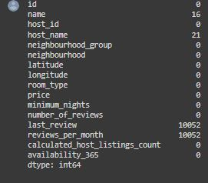
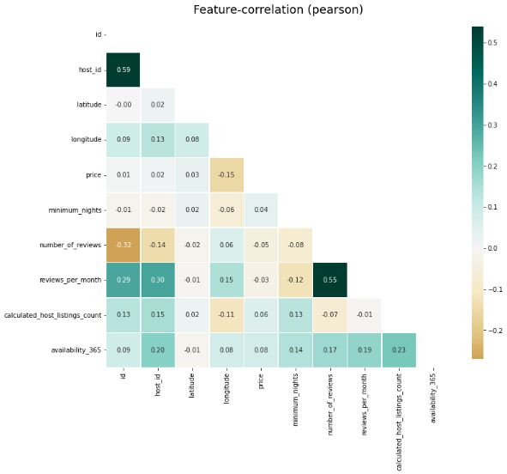
EDA :
Let’s check the null values in data set.
  As we can see in the data column ‘last_review & reviews_per_month’ having a large number of null values.
Let’s check the correlation between columns.
  As we can see that ‘host_id & id’ , ‘reviews_per_month & number_of_reviews’ have good relation in dataset.
  On other side ‘number_of_reviews & Id’ also have good relation.

Slide 15
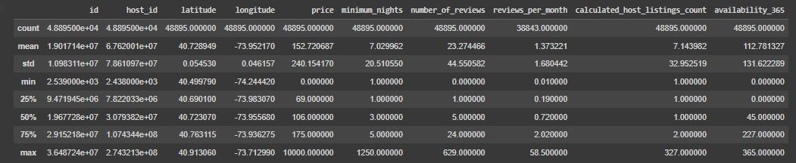
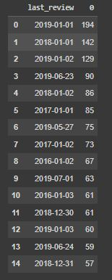
EDA :
  As we can see here in “Price column” the minimum price is ‘0’ that looks strange.
  And in “availability_365” 25%ile of data is ‘0’ that seems awkward let’s check the accurate data in “availability_365” having ‘0’ availability.
  There is approx. 36% of ‘availability_365’ data is ‘0’ is bit shocking if you have a business providing stays on Airbnb and the availability is ‘0’ days that is an extreme case and extreme cases are shocking when it comes 36% .
  Let’s check by ‘last_review’ either that house are still Open or Closed.
  The dataset is of the period of ‘2011-19’ and we can see in the ‘last_review’ table there is some review which was delivered in ‘2016, 2017’ which show either that listings are already closed or not preferable.
  Now let’s fill the price table on behalf of mean price of same ‘room_type’ holding price more than ‘0’.

Slide 16
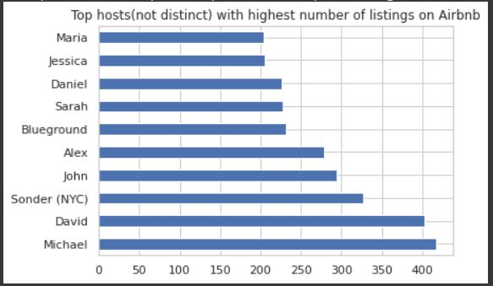
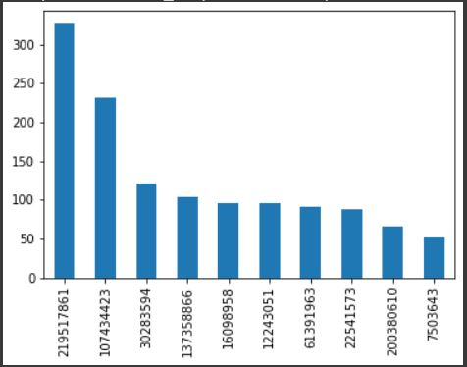
EDA :
EDA :
1. Highest number of apartment owned by host.
  As we can see in above fig. ‘Michael’ has highest number or apartments, but as we know ‘Name’ is not unique here so let’s check by ‘Id’.
  In fig. above we can se the ‘id-219517861 which belongs to Sonder (NYC)’ has highest number of apartments,
  It happened because ‘Id’ is unique here but host_name ‘Michael’ is more than one here .

Slide 17
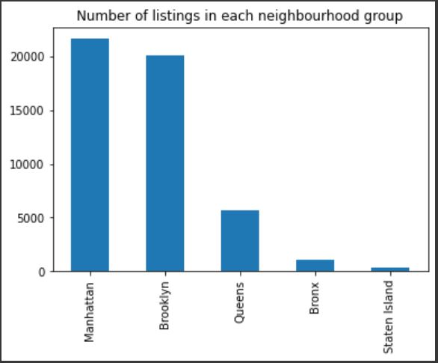
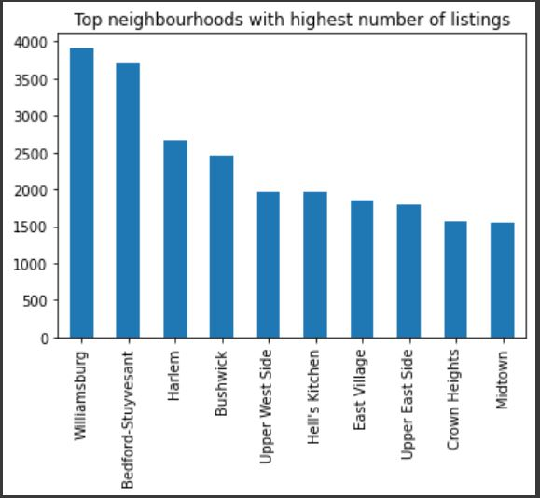
ED :
EDA :
2. Top 10 neighbourhood having highest number of apartments.
  We can see in fig. that “Manhattan” in ‘neighbourhood_group’ have maximum number of listing.
  We can see in fig. that “Williamsburg” in ‘neighbourhood’ have maximum number of listing.

Slide 18
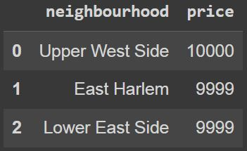
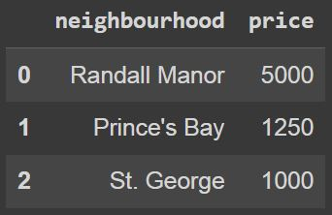
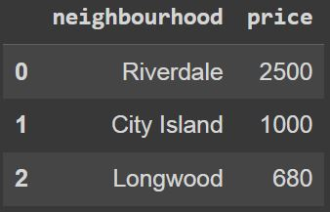
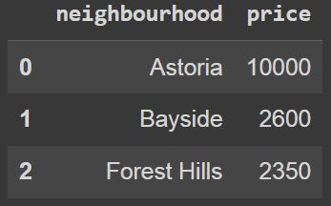
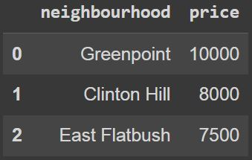
EDA :
3. Top 3 neighbourhood having maximum price in each neighbourhood_group.
Manhattan
Staten Island
Bronx
Queens
Brooklyn
  As we can see in neighbourhood_group ‘Manhattan’ there is approx. no different in price of top three ‘neighbourhood’.
  As we can see in neighbourhood_group ‘Staten Island’ there is much different in price of first and second ‘neighbourhood’.
  As we can see in neighbourhood_group ‘Bronx’ there is much different in price of all top three ‘neighbourhood’.
  As we can see in neighbourhood_group ‘Staten Island’ it’s much larger different in price of first and second ‘neighbourhood’.
  As we can see in neighbourhood_group ‘Manhattan’ there is not much different in price of top 3 three ‘neighbourhood’.

Slide 19
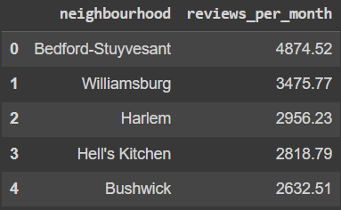
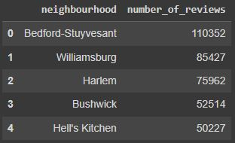
EDA :
4. Relation between neighbourhood and reviews.
  In the data we can clearly see that the neighbourhood ‘Bedford_Stuyvesant’ has highest number of ‘reviews_per_month’ and ‘number_of_reviews’.
  With this data we can easily predict that as larger number the reviews as busiest the host.
  But this can not be always true as all guest do not submit the reviews, but this will help us in finding busiest host.

Slide 20
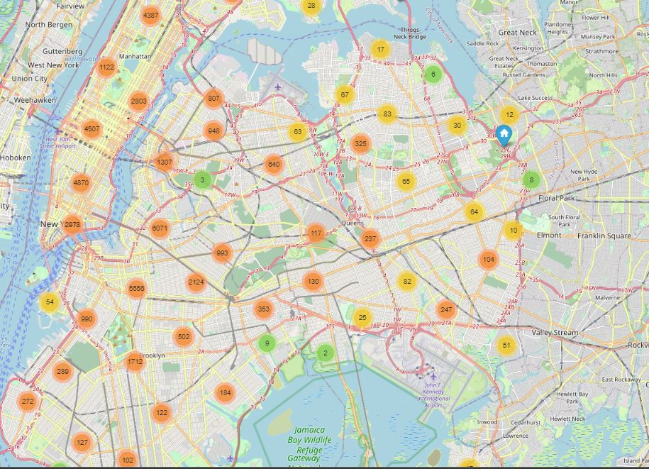
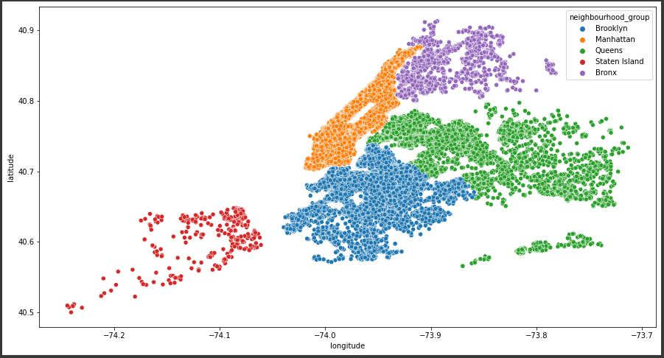
EDA :
5. Learning from prediction(location).
  Map shows the exact location of all the apartments with the help of ‘latitude’ and ‘longitude’ co-ordinates.
  Scatterplot on Map shows the cluster of ‘neighbourhood_group’ with the help of ‘latitude’ and ‘longitude’ .
  We can easily see that ‘Manhattan’ is most dense area which has maximum number of listings.

Slide 21
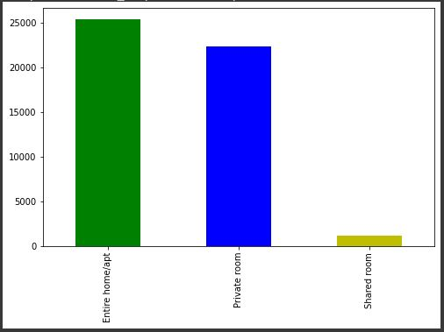
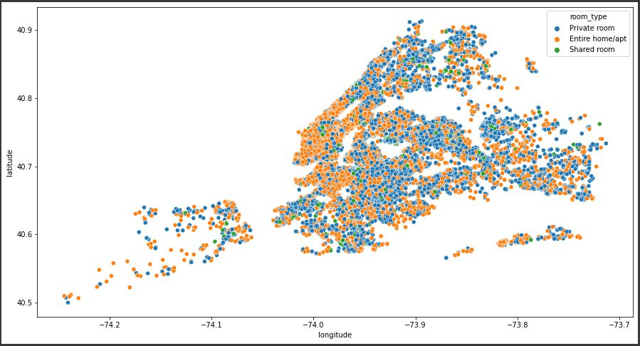
EDA :
6. Room_type distribution over the location.
  Room type of most number of listing is ‘Entire home/apartment’, but there is not big difference in ‘private room and Entire home’.
  But if we talk about ‘Shared room’ we can see a huge difference here, and on the basis of this data we can say that ‘Shared rooms’ are not preferable .
  Scatterplot on Map show the cluster of ‘room_type’ .
  And we can easily predict that ‘room_type’ is almost same in every ‘neighbourhood’, which means the booking of room type is almost same in every ‘neighbourhood’.

Slide 22
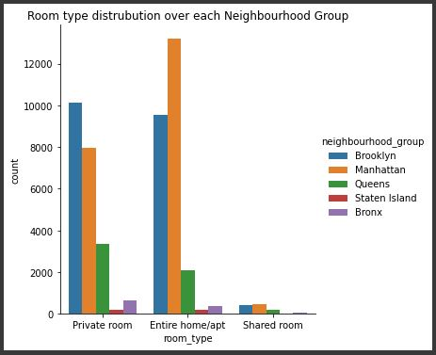
EDA :
  With the help of this data we can understand the distribution of different ‘room_type’ in different ‘neighbourhood_group’.
  According to data ‘private rooms’ are most located in ‘Brooklyn’ and ‘Entire home/apartment’ are most located in ‘Manhattan’ and ‘Shared rooms’ are most located in ‘Manhattan’.
  But if we talk about ‘Shared room’ we can see a huge difference here, and on the basis of this data we can say that ‘Shared rooms’ are almost not preferable .
  ‘Brooklyn’ and ‘Manhattan’ are almost similar to each other but if we see other neighbourhood_group there is a huge different in ‘room_type’ and count of room_type listed.

Slide 23
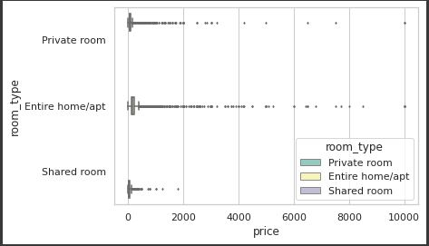
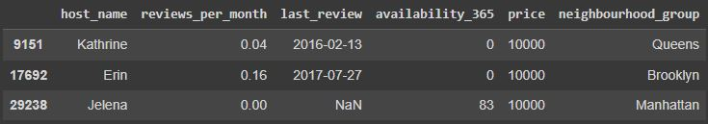
EDA :
7. Price distribution across the room_type
  We can notice that there are many outliers for price column for each of the ‘room_type’ category, so lets just check why there is so high price or what else we can conclude for hosts having highest price for the rooms.
Some suggestion that can help the hosts as well as the guest.
Kathrine and Erin have so high price and having no availability then what is the benefit of keeping too high price.
The last review is also 2-3 years back (as the data was collected in 2019) which is also bad
The reviews may be low as there may be very few people who had stayed Kathrine's, Erin's and Jelena's apartment so they have very less reviews per month
I would have suggested to keep moderate(average) price so that more people would visit and stay in their apartment, it would also increase the reviews per month

Slide 24
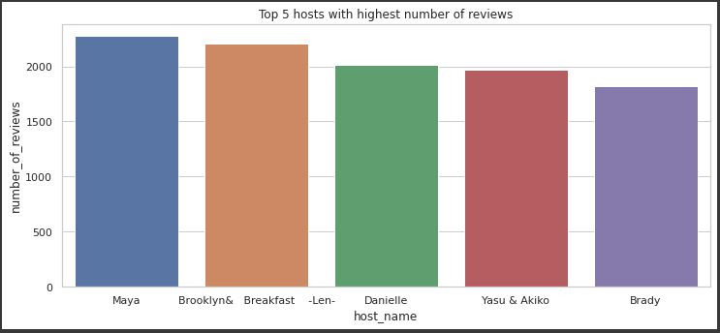
EDA :
8. Top 5 host who received highest number of reviews.
  We can see in all top 5 hosts there is not a big difference.
  We can assume with this data that all 5 host may be the busiest host according to review, but as we have already seen that some of the reviews are from past years that may infer that the homes are already closed or not preferable.
  But if we could filter the data then reviews can be a source to find busiest host.

Slide 25
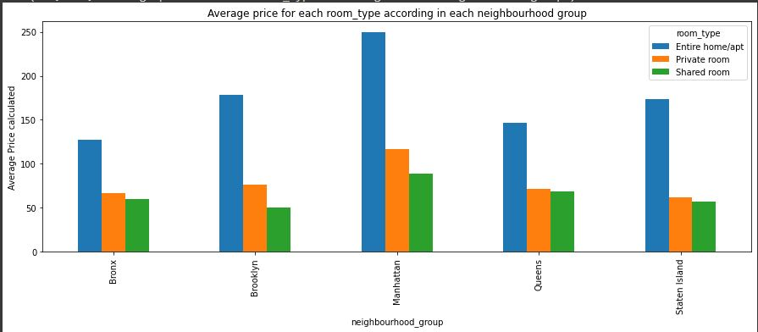
EDA :
9. Average price of each room_type in each neighbourhood_group.
  Observations: As we can see that Manhattan is most costly and bronx is cheap for each room_type.
  But I think we can make it more useful for business implementation if we do some analysis on successful hosts according to the highest no of reviews so that we can suggest that price to our hosts to get good business.
  We seen before that shared rooms are not preferable here we can see one that reason, that is price, of shared room and private rooms are likely similar it may be one of the reason shared rooms are not preferable by guests.

Slide 26
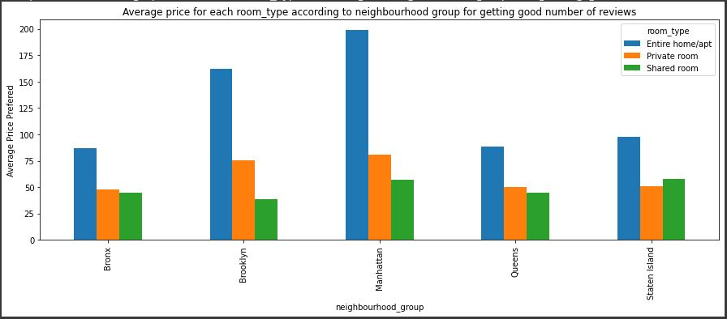
EDA :
10. Average price preferred to get good number of reviews.
  Observations:
    Clearly if we compare the results with previous result (i.e when we calculated average price preferred by people in each neighbourhood_group with different room_types) we can see that this result is bit different and more useful.
    As an analyst we would suggest to keep price in this range to get more number of reviews in specific room type and at a particular place.

Slide 27
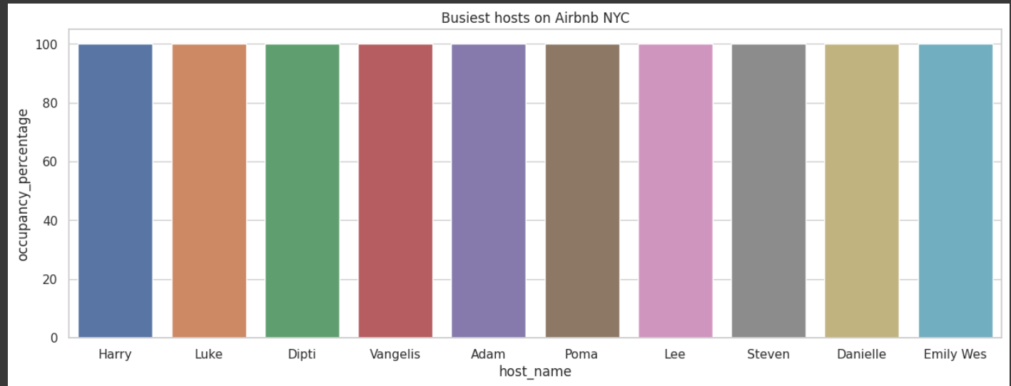
EDA :
11. Top 10 busiest host.
  Observations:
The `host_name` column as discussed before contains
repeating names, the `calculated_host_listings_count`
gives us a fair idea of how many properties in total a host
owns. The use of `host_id` as primary key for the groupby
function is the only way. Followed by `host_name` for
groupby since the names of the hosts is important in the
analysis.
The mean is used as the aggregating function for the
`occupancy_percentage` and price columns to get a fair
idea about the general trend for each host, whereas for the
`neighbourhood_group` and `neighbourhood` columns,
the mode indicating the location where majority of host's
properties reside, is used. The mode is chosen for the
location columns because, the mode i.e. most frequent
location for property means the majority of contributions
to the `occupancy_percentage` come from here.

Slide 28
Challenges faced :
While doing the analysis we found out that 36% of the data has 0 availability in the availability_365 column, which is an extreme case. But we didn’t have other relevant required data so we couldn’t alter this column.
Further, we found out that there were many listings whose price was 0, which is not normal. So, we filled these values by the respective median price and updated the price column.
While getting host_name with the highest listings we found out that there are many hosts whose names are the same so we went by host_id as this is unique, host_name is not unique.
There are many listings whose date of the last review is very old this can mean that they must’ve stopped their business then those listings are of no use to us for doing analysis at present. But this assumption can also be wrong so we didn’t alter that column.
There were many outliers in the price column of some hosts which weren’t benefitting the host as well as the customer.
The biggest challenge that we faced is finding the busiest hosts. If we try to find the busiest hosts by an only number of reviews then this may be not the correct metric, because we don’t know the current status of the host having the highest number of reviews. For example, if we check that one host has x number of reviews which is highest but when we check the date of last_review and find out that the reviews are very old than the current date, then we can infer that business is currently shutdown so how can we take such hosts into consideration for knowing the busiest hosts. Ideally, the busiest host should be that one whose occupancy is almost full.

Slide 29
Conclusions :
Sonder(NYC) host is having most number of listings on Airbnb in NYC.
Williamsburg neighbourhood has most number of listings.
Upper West Side, Astoria and Greenpoint neighbourhoods have costliest listing in NYC.
Bedford-Stuyvesant neighbourhood has highest number of total reviews and Theater District neighbourhood has highest number of reviews_per_month.
Maximum listings are listed on Manhattan and Brooklyn neighbourhood_groups. Staten Island and Bronx neighbourhood_group have very less numbers of listings.
Most of the listings on Airbnb in NYC are either Entire Home/Apartment or Private Room. The people who prefer to stay in entire home/apartment are likely going to stay longer, whereas people who prefer to stay in private_room are likely to stay for a shorter period of time than the people who prefer to stay in entire home/apartment.
Many rows are having values as 0 in price column, so this seems like an error which must be rectified by Airbnb.
Keeping high price of the listing and have 0 availability isn't benefitting the host as the consumer is ready to pay the price but even after that there are no available rooms then what's the benefit of paying such a premium.
Maya (host) has the heighest total number_of_reviews.
Average prices of all the room_types in Manhattan are more than the average price of each room_type in other neighbourhood_group. Average prices of all the room_type in Bronx neighbourhood_group is less than all the other neighbourhood_groups.

Slide 30

Thank You

